Slide 1

How Does a Bike-Share Navigate Speedy Success? June 2022 Md Sahil

Slide 2
Table of contents
Brief Introduction
Goal of the Project
Analyzing
Conclusion

Slide 3
Introduction
The bike-share offering program launched by Cyclistic in 2016.
There are 5,824 bicycles with geotrack that are locked into a network of 692 stations across Chicago.
The bikes can be unlocked from any of one station and returned to any other station in the system anytime.
There are 3 flexible pricing plans –single-ride passes, full-day passes and annual memberships.
Customers who purchase single-ride or full-day passes are considered as casual riders.
Customers who buy annual memberships are considered as Cyclistic members.

Slide 4
Goal of this study
Key business Task
How do annual members and casual riders use Cyclistic bikes differently?
Why would casual riders buy Cyclistic annual memberships?
Goal of this study
How do annual members and casual riders use Cyclistic bikes differently?
How can Cyclistic use digital media to influence casual riders to become members

Slide 5
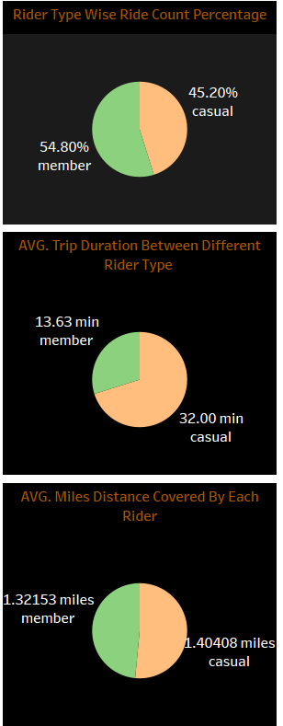
Analyzing numbers
First Pie chart shows percentage of casual and member among riders.
Second pie chart shows Average trip duration between casual and member. And we clearly see average trip duration of casual is double than average trip duration of member.
Third pie chart shows average distance covered by casual and member. It is clearly shows average distance covered by casual slightly higher than member.

Slide 6
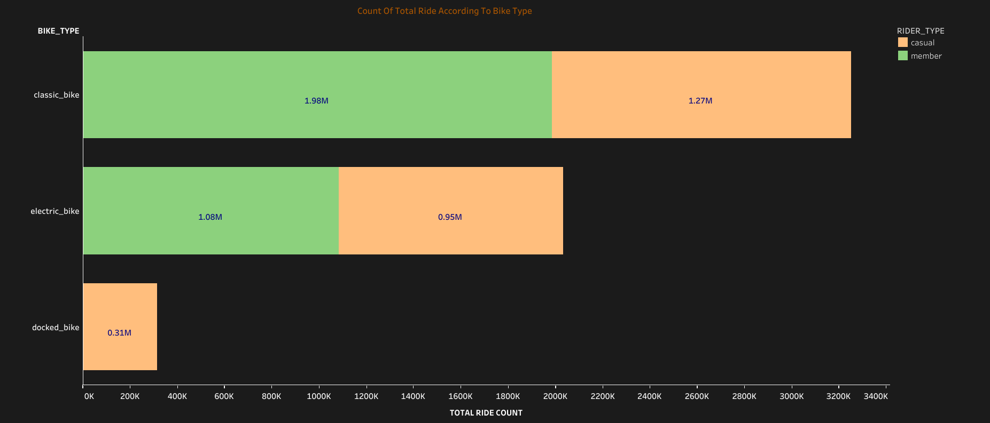
Analyzing rider according bike type
Docked bike is the least used bike and only used by casual member.
Classic bike is highest used bike and member used more than casual.
Electric bike is moderate used bike and used ratio between casual and member nearly 1:1.

Slide 7
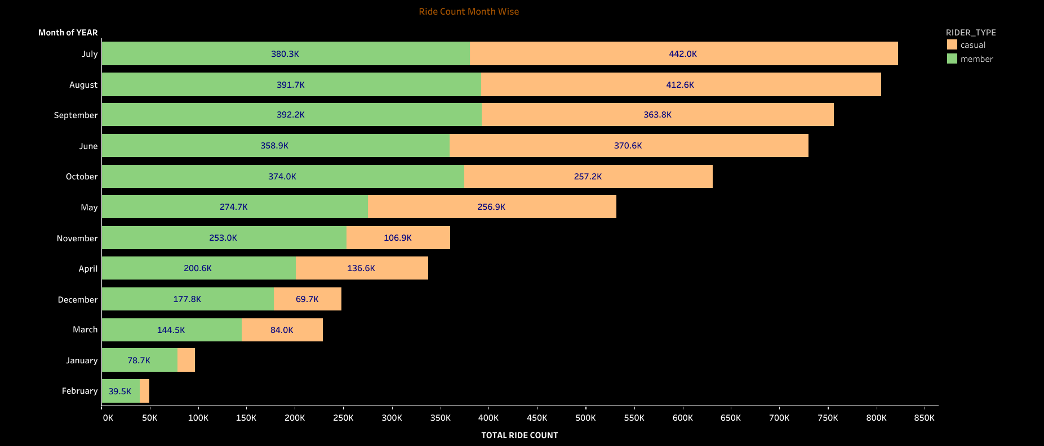
Analyzing ride count month wise
In month July, August, September and June have highest ride count as well as casual ride count.
In month February and January have lowest ride count as well as casual ride count.

Slide 8
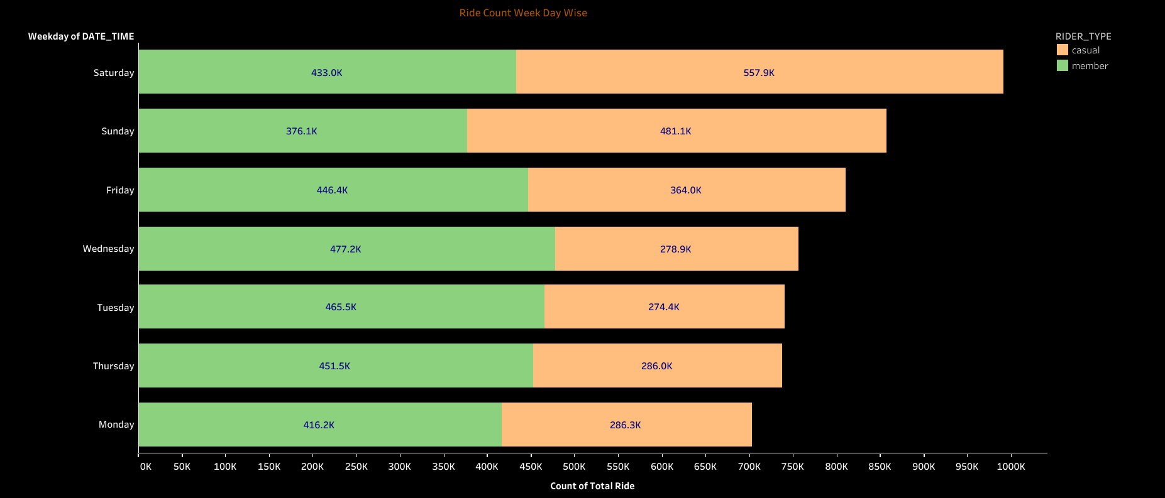
Analyzing ride count weekday wise
In Weekend has highest ride count as well as casual ride count.
On Monday and Tuesday have lowest ride count as well as casual ride count

Slide 9
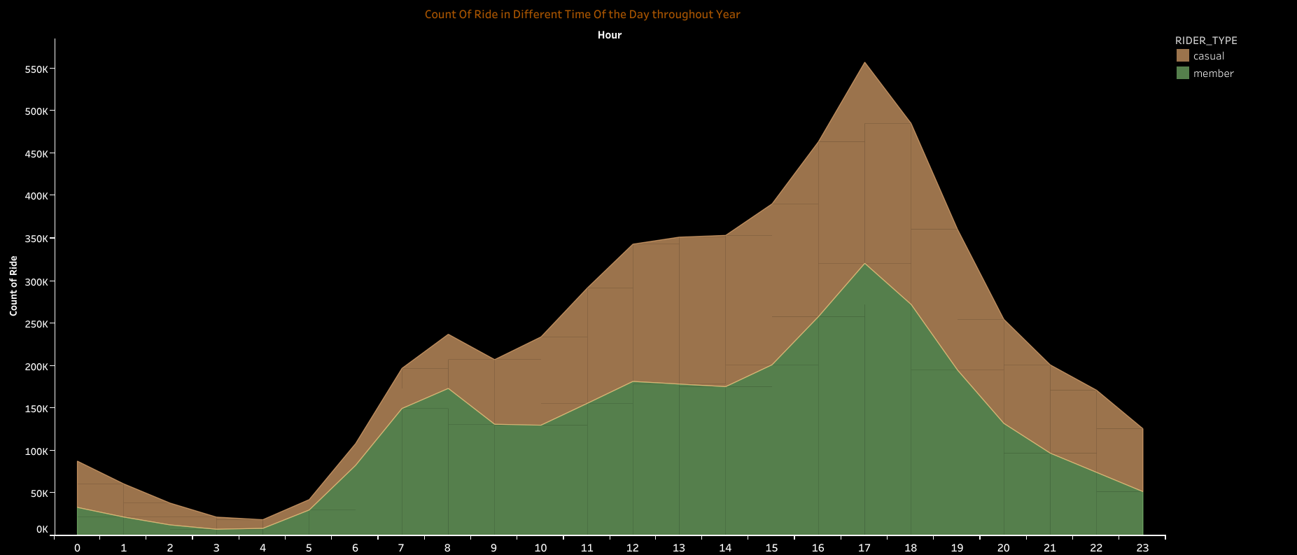
Analyzing ride count hour wise
In hour 16,17,18,19 (4 P.M.-7 P.M.) have highest ride count as well as casual ride count.
In hour 0,1,2,3,4,5 (12 A.M.-5 A.M.) have lowest ride count as well as casual ride count

Slide 10
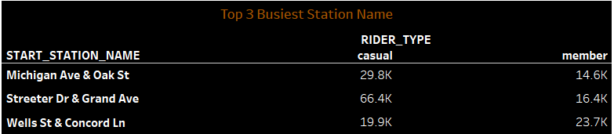
Analyzing busiest station
These 3 stations have most busy station.
Among these 3 station Wells St & Concord Ln station has most casual rider.

Slide 11
Conclusion
Marketing campaign shall be done during the months of June, July, August and September.
Weekends should be prioritized when it comes to scheduling ads. The best time for ads is the afternoon and evening time ie. 4 PM - 7 PM.
Marketing strategies should emphasize on "Casual riders with more number of rides with shorter ride length”.
Top 3 station for ad campaign are Michigan Ave & Oak St, Streeter Dr & Grand Ave and Wells St & Concord Ln. And special focus to Wells St & Concord Ln station.

Slide 12
Thank You

